Slide 1
GitHub Collaboration and
Project Week
Lesson 8.1

Slide 2
PreClass Challenge

Slide 3
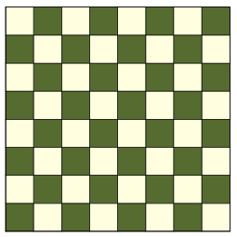
Calculate N’th Square – Math Fun (6:00 – 6:20)
Given a chessboard, calculate the ROW and COL of the ‘N’th square
Col 0 1 2 3 4 5 6 7
Row 0
Row 1
Row 2
Row 3
Row 4
Row 5
Row 6 Row 7
0
1
2
3
4
5
6
7
9
Given:
N = 19
Return:
Row = 2
Col = 3
8
10
11
12
13
14
15
16
17
18
X

Slide 4
Calculate N’th Square – Math Fun (6:20-6:30)
You COULD do it with a couple LOOPS
function findSquare(n) {
var square = 0; for(var irow=0; irow<8; irow++) { for(var icol=0; icol<8; icol++) {
if (square === n) {
return {row: irow, col: icol }
}
square++;
}
}
return undefined;
}

Slide 5
Calculate N’th Square – Math Fun (6:20 – 6:30)
BUT – Math is faster … and clearer
function findSquare(n) {
var irow = n / 8;
var icol = n % 8;
return {row: irow, col: icol};
}

Slide 6
Admin Items
jQuery $(Begins)

Slide 7
Administration… (6:00 – 6:05 PM, 5 mins)
Homework #7 (Train Times)
Due Tuesday, July 2nd, @11:59pm
Turn in whatever you have!
Video Guide for this week: /07-firebase/VideoGuide.md
Use Tutors if you need them
When you get a SURVEY, be BRUTALLY HONEST!
Sign into BootCampSpot and mark your attendance
Any Questions from Last Time?
jQuery $(Begins)

Slide 8
Project Week Overview

Slide 9

You Made It to Project Week!
Notes:
shutterstock_632097335

Slide 10
Welcome to Project Week (6
Welcome students and explain that we will be going over collaborative workflows with Git before diving into working on projects.
Explain that in addition to just using Git and Github to push up our own code, these powerful tools allow allows multiple developers to work on the same codebase independently of each other.
Students should sit with their groups during today's activities and work to follow along with the examples.

Slide 11
If time permits and you would like to show students a free mockup tool before they begin their brainstorming session,pencil project is a free open-source desktop GUI prototyping tool.
Instructors / TAs, take a few moments before class to review the presentations posted on this link: https://www.youtube.com/playlist?list=PLe80S_8KApqOTw-2-b-sgzTwwWImepoii. Do not share these with students as they are Rutgers Specific -- however, use the insight you gain in watching these videos to understand what's possible.
In Day 2 of Project Instruction we will be telling students to use GitHub Projects. You can let them know this ahead of time so they don't use Trello or another board.

Slide 12



Project Week at a Glance: This Week (6:30-6
Day 1:
Day 2:
Divide into groups.
Dive in to project development.
Begin researching APIs.
Work closely with instructors and TAs.
Outline project ideas.
Day 3:
Submit project proposal for approval.
Continue project development.
Begin initial design work.

Slide 13
Project Week at a Glance: Next Week
Day 4:
Continue project development.
Day 5:
Continue project development.
Prepare for presentations.
Day 6:
Give presentations!

Slide 14
The Great Push
Take Project Week seriously.
Use Project Week as an opportunity to push yourself and prove what you know.
Because you DO know!

Slide 15
Project Teams

Slide 16
Project Requirements
Use at least two APIs.
Use AJAX to pull data.
Use at least one new library or technology that we haven’t discussed.
Create a polished front end/UI .
Meet good quality coding standards (indentation, scoping, naming, etc.).
Do NOT use alerts, confirms, or prompts (look into modals).
Incorporate some sort of repeating element (table, columns, etc.).
Use Bootstrap or an alternative CSS framework.
Deploy your site to GitHub Pages.
Include user input validation.

Slide 17
Bonus
Utilize Firebase for persistent data storage.
Make your site mobile responsive.
Use an alternative CSS framework such as Materialize.

Slide 18
Presentation Requirements
You will be responsible for preparing a formal, 10-minute presentation that covers the following:
The overall concept of your application
Your motivation for developing the application
Your design process
Technologies used (and a brief description of how they work)
A demonstration of the application’s functionality
Directions for future development
Treat the presentation seriously!
Sometimes, talking intelligently about tech > doing tech.

Slide 19
Metrics

Slide 20
Project Metrics
Your project will be evaluated on the following:
Concept
Design
Functionality
Collaboration
Presentation

Slide 21
Awards
Projects will receive awards in the following areas:
Most Awe-Inspiring
Most Useful
Most Creative
Best Use of Tech
Best UI/UX
Most Hilarious
Most Disruptive
Most Socially Conscious

Slide 22
API Suggestions

Slide 23
API Suggestions
Stick to APIs that do all of the following:
Allow cross-origin resource sharing (CORS)
Require simple or no authentication
Return a JSON response
Are well documented

Slide 24
API Suggestions
Find a collective list (updated daily!) of free APIs for use in software and web development here: public-apis
Spotify | Pinterest
Reddit | Google
YouTube | Tumblr
LinkedIn | OpenStreetMap
SoundCloud | Giphy
Wikipedia | BitCoinCharts
Flickr | Stack Exchange

Slide 25
Tools

Slide 26
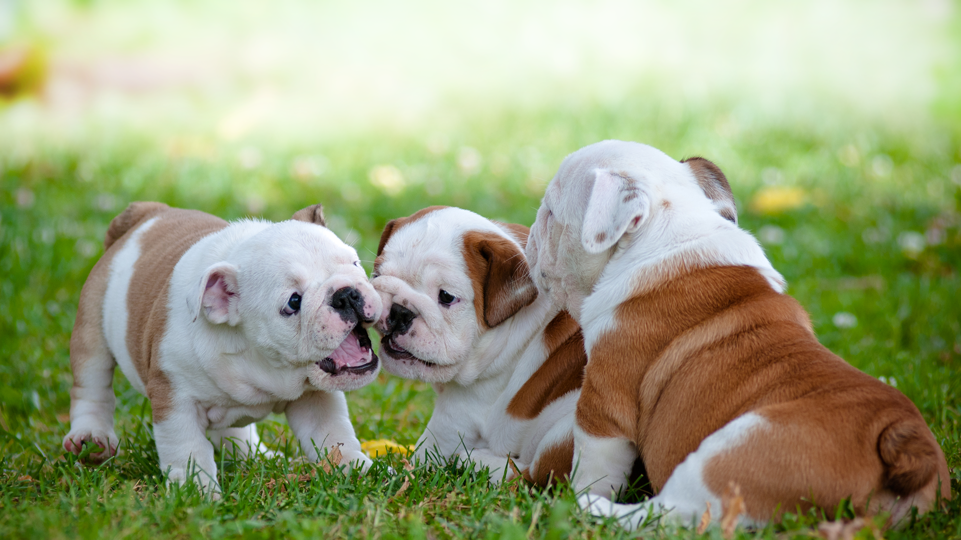
Collaboration Is Critical!
Steering a project with remote developers can be challenging.
Consider using the following tools.
Notes:
shutterstock_81648802

Slide 27





GitHub Pull Requests
GitHub pull requests are a great way to “combine” code when multiple users are working on the same files. We’ll show you how to use this feature in the next class.
 | Git Branch <branchname> Creates a local branch, or alternative version of code. However, the "master" branch is still the active branch. | Git Checkout <branchname> Switches the active branch to the alternative branch. Local code files and changes will be saved to this branch.
1
2
3
4
5
6
1
2
3
4
5
6
GitHub
Versions
Versions
COMMAND
Master
New Branch
New Branch
Master
Now Active
YOUR COMPUTER
Local Project Folder
Local Project Folder
Notes:
Trilogy created this diagram and it doesn’t violate copyright laws.

Slide 28
GitHub Issues are a great way to keep track of bugs, feature requests, and more.

Slide 29
GitHub Projects is a great
project management tool
for creating to-do lists and communicating updates.

Slide 30
Example Project Ideas

Slide 31

Example Project Ideas
Event Searcher:
Users type in the name of their favorite sports team.
Using the SeatGeek API, your web application points users to the time and location of the team’s next game.
The web application also provides users with an eBay link to purchase memorabilia associated with the team.
Notes:
Image from: shutterstock_404793301

Slide 32
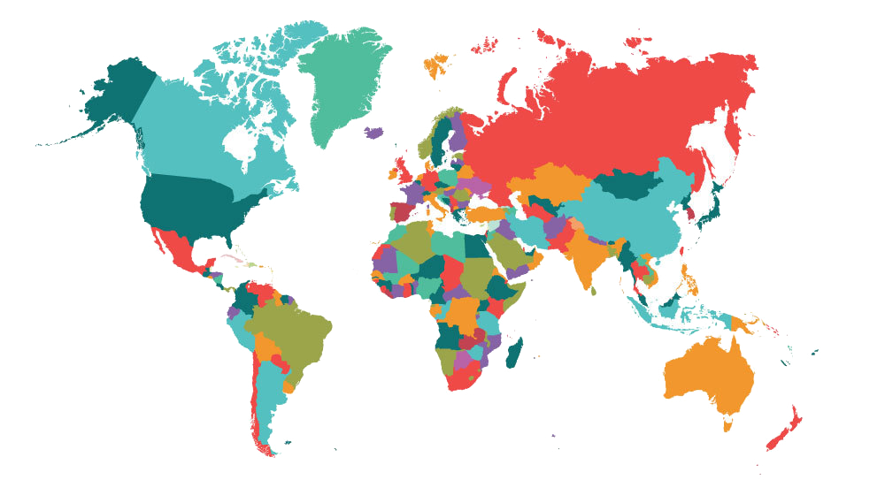
Example Project Ideas
UN Data API:
Use the unofficial UN Data API to search a user-specified country’s health records.
Use a secondary data source (Google Maps, Flickr, YouTube, etc.) to provide additional context or data.
Examples: per capita government expenditures on health; number of physicians; deaths due to HIV, malaria, etc.; low-birth-weight newborns.
Notes:
Image from: shutterstock_525077839

Slide 33

Example Project Ideas
Facial Recognition:
Use the Face++ API.
Allow users to provide a link to a facial image, and then provide viewers with information about the image’s gender, race, age, and whether they are wearing glasses.
Notes:
Image from: shutterstock_1255208941

Slide 34

Or just do your own thing.
Be creative! Be ambitious!

Slide 35
Today’s Focus

Slide 36
Today’s Project Checklist
Brainstorm possible project ideas.
Begin API research.
Create an initial draft and sketch of the design.
Create a short (1 page) proposal that contains the following:
Project title
Sketch of the design
Team members
APIs to be used
Project description
Rough breakdown of tasks

Slide 37
Questions?

